Slide 1
Introduction to Database and DBMS Part I
Lecture 4

Slide 2
Objectives
Identify a DB and a DBMS
Characteristics and problems of data storage mechanisms
The advantages and disadvantages of the DB approach
The major components of a DBMS
Levels of abstraction in a DBMS

Slide 3
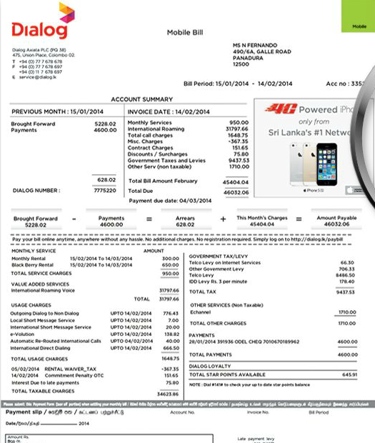
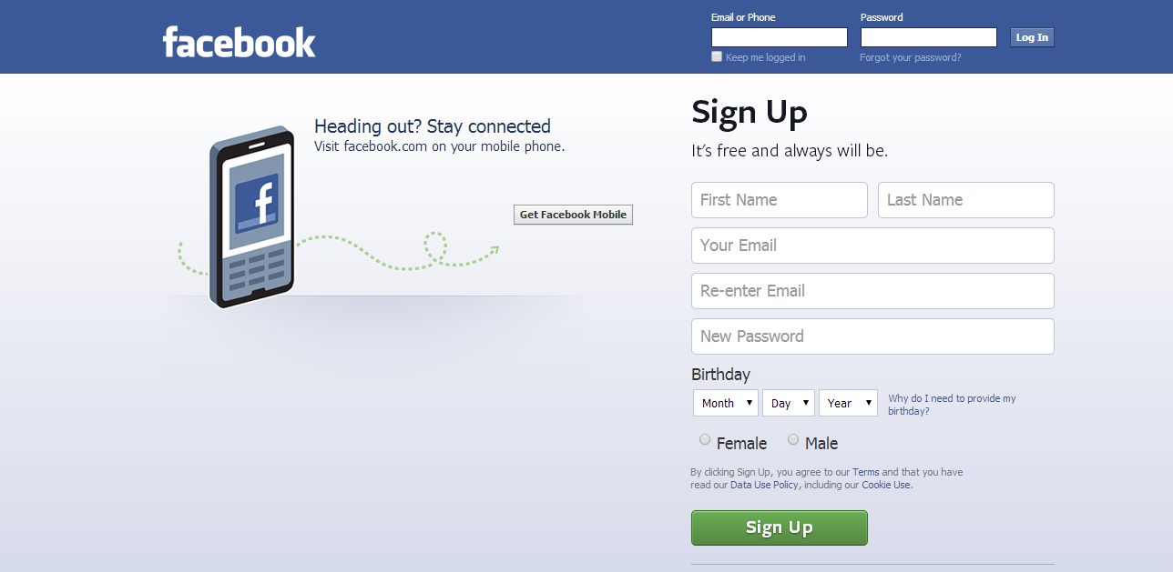
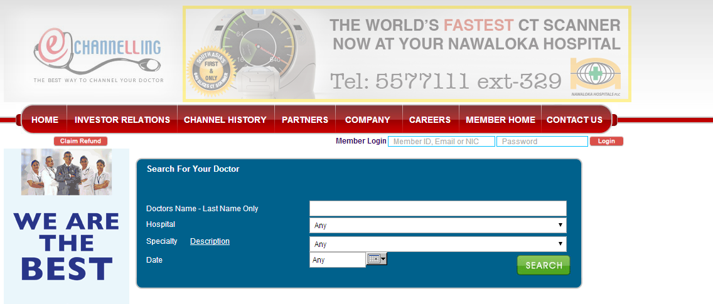
How do you produce these information?

Slide 4
Database
What is a database?
Database is a collection of related data
(examples???)

Slide 5
Places Where databases are used
Banks: ATM
Airlines: reservations, schedules
Universities: registration, grades
Sales: customers, products, purchases
Manufacturing: production, inventory, orders, supply chain
Human resource Management Systems: employee records, salaries, tax deductions
Databases touch all aspects of our lives…

Slide 6
DBMS
What is a DBMS (Database Management System)
Set of programs to access the data
Is a software package designed to create and maintain databases

Slide 7
DBMS (contd…)
The DBMS is a general-purpose software system
Defining
Specifying the data types, structures, and constraints for the data to be stored in the database.
Constructing
The process of storing the data itself on some storage medium that is controlled by the DBMS.
Manipulating
Manipulating a database includes such functions as querying the database to retrieve specific data, updating the database to reflect changes, and generating reports from the data.

Slide 8
DBMS examples
DBMS | Vendor | Type | Primary Market
Access | Microsoft | Relational | Desktop
SQL Server | Microsoft | Relational | Enterprise
SQLBase | Centura Software | Relational | Mobile/Embedded
Teradata | NCR | Relational | VLDB (Data Warehousing)
DB2 | IBM | Object Relational | Enterprise/VLDB
Informix Dynamic Server 2000 | Informix | Object Relational | Enterprise
Oracle 8I | Oracle | Object Relational | Enterprise
Oracle Lite | Oracle | Object Relational | Mobile
MySQL | Freeware | Relational | Open Source
PostgreSQL | Freeware | Object Relational | Open Source
Etc…

Slide 9
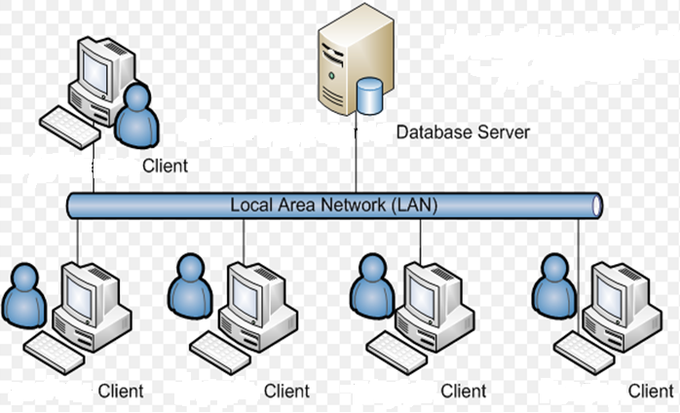
DB Architecture

Slide 10
End of Lecture 4

